Slide 1

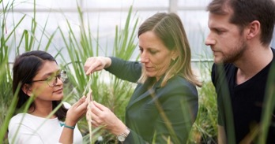

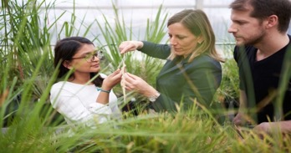
Components of an
Ag Innovation Ecosystem
Network of Collaborators
ACCESS TO MARKET
Within 500 mile radius, 50% US ag production
$88 Billion MO industry
National HQ of
National Corn Growers
American Soybean Association
US Farmers and Ranchers in Action
INVENTIONS
Danforth Center
Washington University
University of Missouri
St. Louis University
Industry leaders
TALENT
1,000+ Plant Science PhDs
Education and Training
Skilled Labor
Culture
Accelerators
INFRASTRUCTURE
Laboratories
Greenhouses
Plant Transformation
Proteomics
Data Science
Advanced BioImaging
BRDG Park
Helix Center
BioGenerator
39 North
FUNDING
Advantage Capital
Arch Angels
Bayer Growth Ventures
BioGenerator
Cultivation Capital
Lewis & Clark AgriFood
Oakwood Ventures
Prolog Ventures
Rivervest Ventures
Tech Accel
Yield Lab
Wells Fargo IN² Innovation Incubator

Slide 2

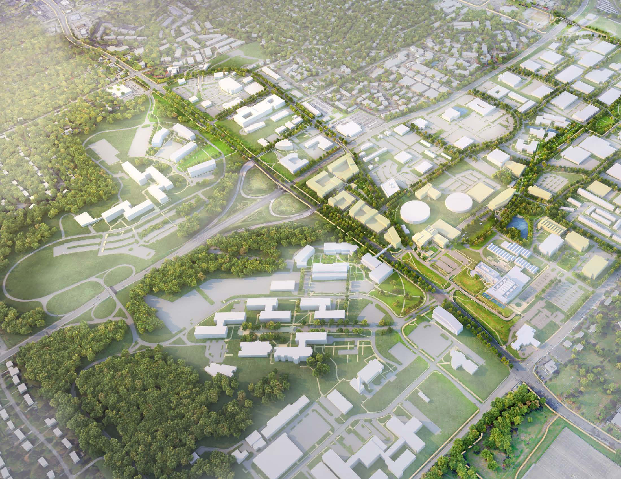
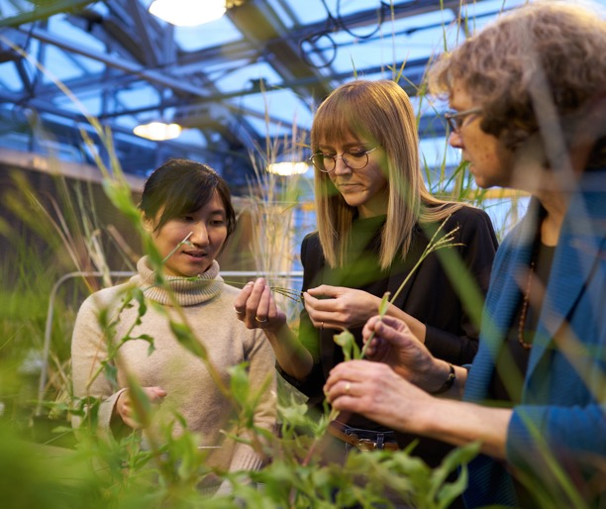


The 39 North Innovation District
Helix
Bayer Crop Science
Danforth/BRDG Park
A 600-acre area of mixed-use activity and development
Anchored by Danforth Center, BRDG Park, Helix Incubator, Benson Hill, Bayer Crop Science, The Yield Lab,
and others
Enhances our region’s ability
to grow, attract, and retain
top talent
Learn More 39NorthSTL.com

Slide 3
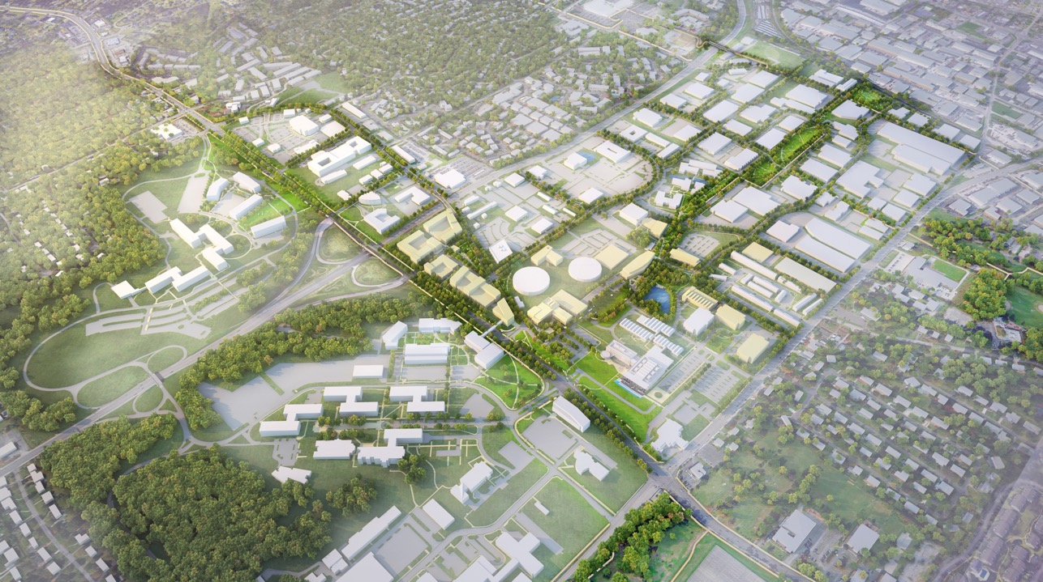
$10.86 Million in Infrastructure Projects
Lindbergh Blvd.
Baur Blvd.
Connect assets
Improve mobility – biking & walking trails & greenspace
Create a mixed-use center of activity
Create development opportunities
Programming – Venture Café
Learn More 39NorthSTL.com
Old Olive Street
Olive Blvd
Helix
Warson Rd.
Bayer
Danforth
Bayer
Olive/Lindbergh Interchange $5.3M
Old Olive Great Street Design $3.26M
39 North Greenway $2.3M
Olive Blvd.
Notes:
Garnered $10.66 million for three key infrastructure projects to improve mobility and create development opportunities
Interchange:
$4 million of federal transportation funding to design and construct the new interchange, a $1 million match from St. Louis County Transportation and $300,000 of funding from the City of Creve Coeur.
Total Investment = $5.3M
Old Olive: The East-West Gateway presented their recommendations to the Transportation Planning Committee resulting in this project being recommended for funding.
Total federal money = $1.16M + $1.6M from MODOT, + $450K from St. Louis County + $10,000 from the City of Creve Couer = Total Investment = $3.26M
Preliminary Engineering money FY 2022 (Oct. 2021) and Construction in FY 2023
Redesign and construction of new intersection at Old Olive and Lindbergh.
Greenway: Biking & pedestrian paths that connect to the Centennial Greenway
$400K for design from GRG. Waiting on Governor’s signature for $1.9M infrastructure funding to build the portion from DDPSC to Helix
Total investment = $2.3M

Slide 4
39 North Core Working Team
Donald Danforth Plant Science Center
BRDG Park
St. Louis Economic Development Partnership
Helix Center
City of Creve Coeur
City of Olivette
Bayer Crop Science
The JCC
Notes:
Implementation of the plan is being coordinated by representatives from ….

Slide 5
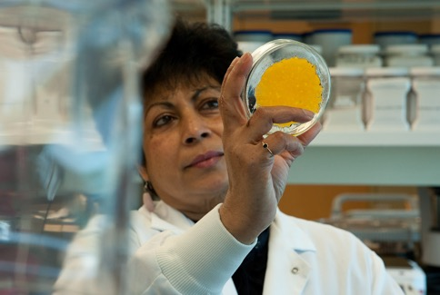
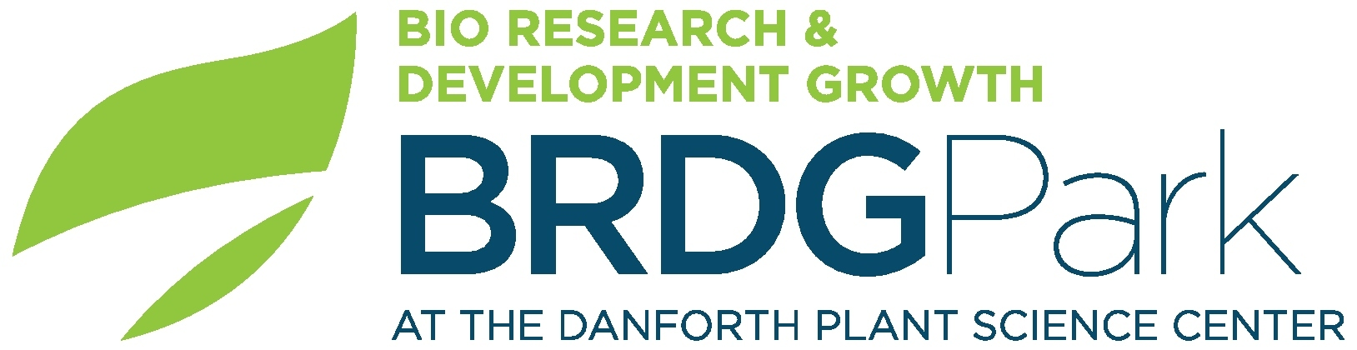
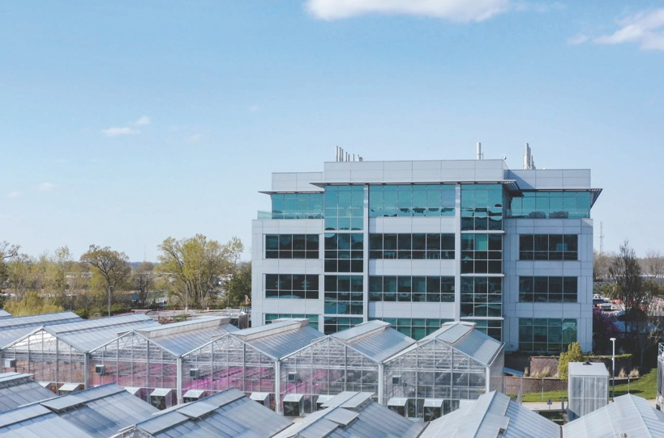
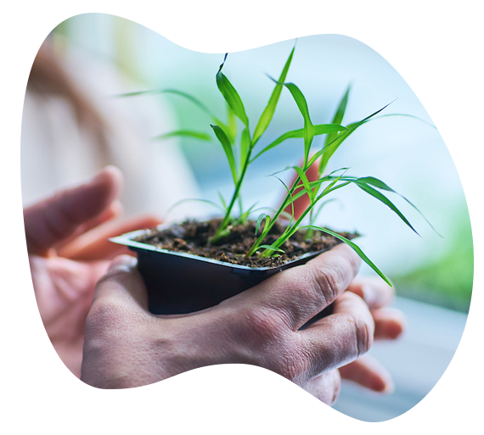
Bio-Research & Development Growth Park
BRDG and new EDGE@BRDG
17 enterprises – start-ups, mid-size companies and multinationals
St. Louis Community College Biotech Training Program
Notes:
BRDG Park opened in 2009 on the Danforth Center campus. Immediately attracted in early and mid-stage startups from Germany, Israel, India, and elsewhere in the U.S. As well as providing space for growing spin-outs from the Center itself.
Today, there is an IP law Firm and a partnership with St. Louis Community College technician training and equipment loan program. Trains science lab workers and provides access to specialized equipment—developing talent and infrastructure to supply new and recruited businesses.
Despite pandemic, the new building EDGE@BRDG opened this summer. It is home to the headquarters of Benson Hill—one of our greatest success stories.

Slide 6

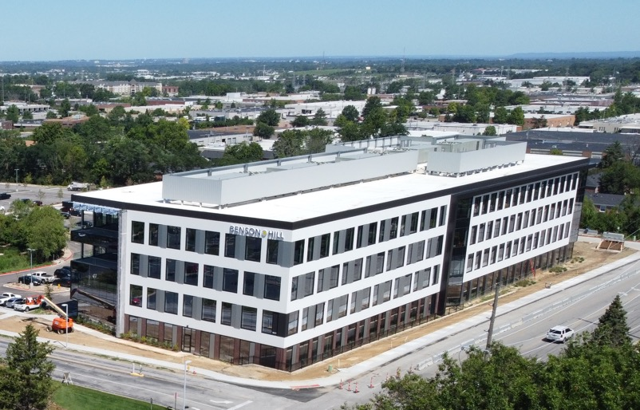
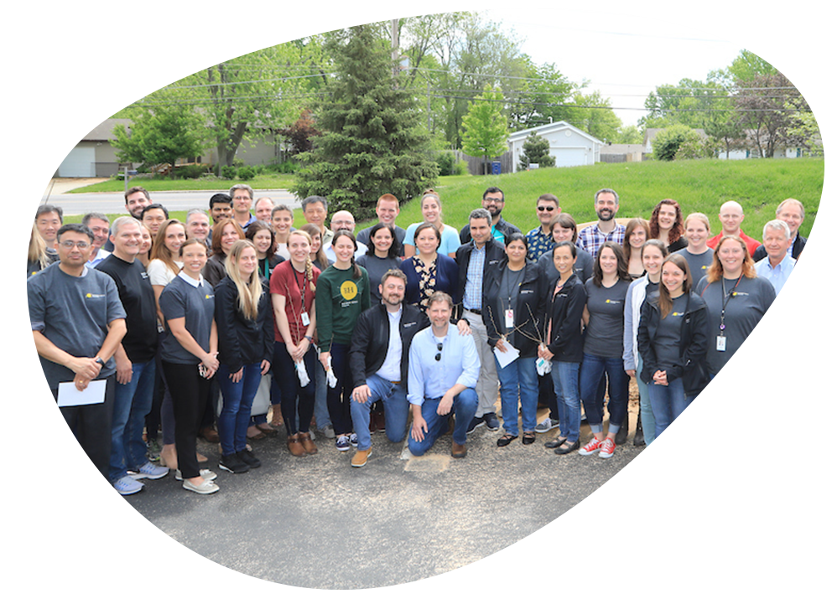
A Danforth Center Impact Story
Danforth Center spinout – co-founded by Todd Mockler, PhD
HQ in new EDGE@BRDG building
More than 300 employees
Company combines AI and genetics to deliver consumer-centered crops, faster!
Going public as a unicorn in Q3 in $1.35B deal

